Slide 1

Assignment 4
.NET Programming using C#
Prof. Nital Shah
By: Maitra Patel
200449121

Slide 2

STEP 2: CREATE YOUR FIRST ASP.NET CORE WEB APP

Slide 3
1> To get Server Time
Index.cshtml.cs
using System;
using System.Collections.Generic;
using System.Linq;
using System.Threading.Tasks;
using Microsoft.AspNetCore.Mvc;
using Microsoft.AspNetCore.Mvc.RazorPages;
namespace Assignment_4.Pages
{
public class IndexModel : PageModel
{
public string Time { get; set; }
public void OnGet()
{
Time = DateTime.Today.ToShortTimeString();
}
}
}
Index.cshtml
@page
@model IndexModel
@{
ViewData["Title"] = "Home page";
}
<h2> It's @Model.Time right now on the server!</h2>

Slide 4
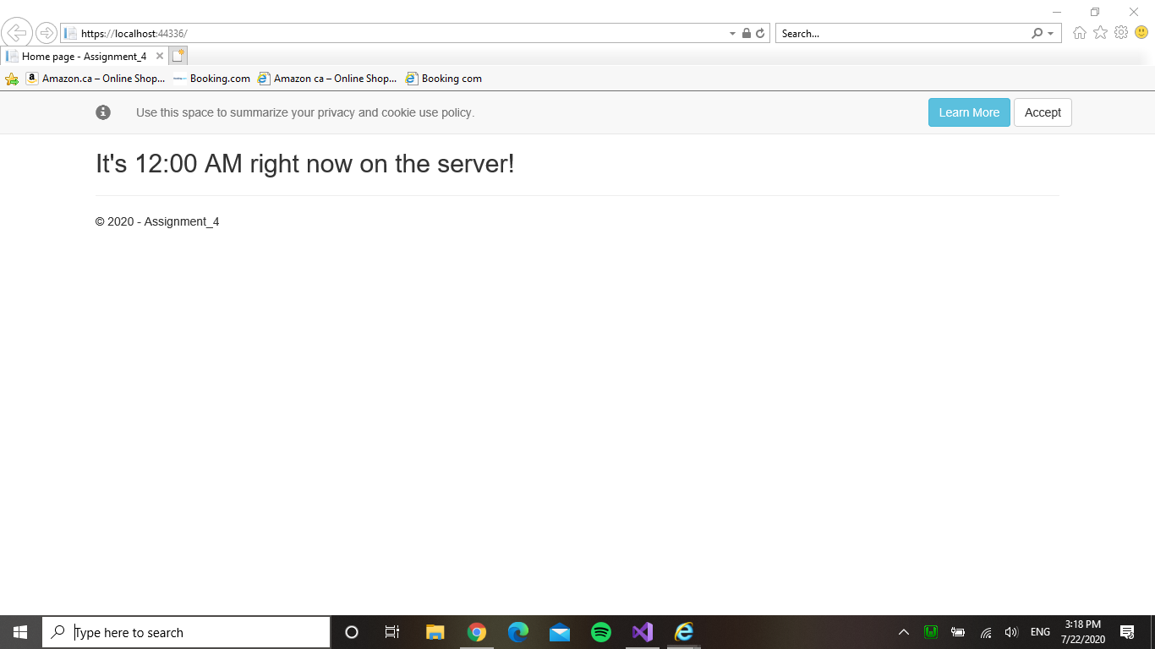
Output

Slide 5
2> To get Local Time
Index.cshtml.cs
using System;
using System.Collections.Generic;
using System.Linq;
using System.Threading.Tasks;
using Microsoft.AspNetCore.Mvc;
using Microsoft.AspNetCore.Mvc.RazorPages;
namespace Assignment_4.Pages
{
public class IndexModel : PageModel
{
public string Time { get; set; }
public void OnGet()
{
Time = DateTime.Now.ToShortTimeString();
}
}
}

Slide 6
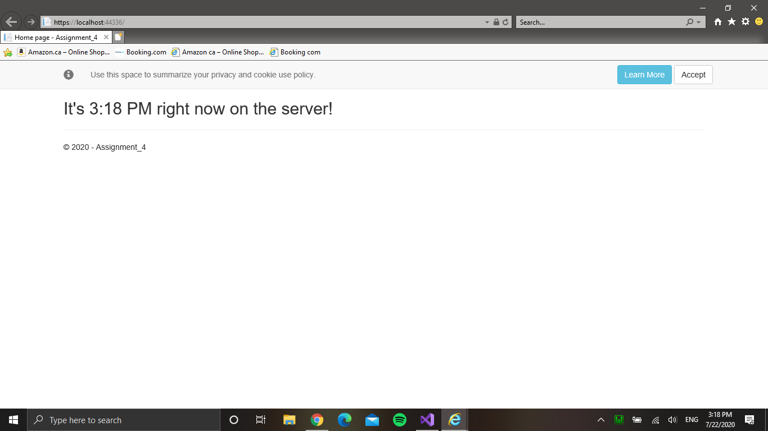
Output

Slide 7
Step 3: Work with data using Entity Framework

Slide 8
After following Step 3
Created Models Folder
Added Game.cs in Models
Created Games Folder in Pages Folder
Added CRUD files in the folder
Made some changes in Program.cs

Slide 9
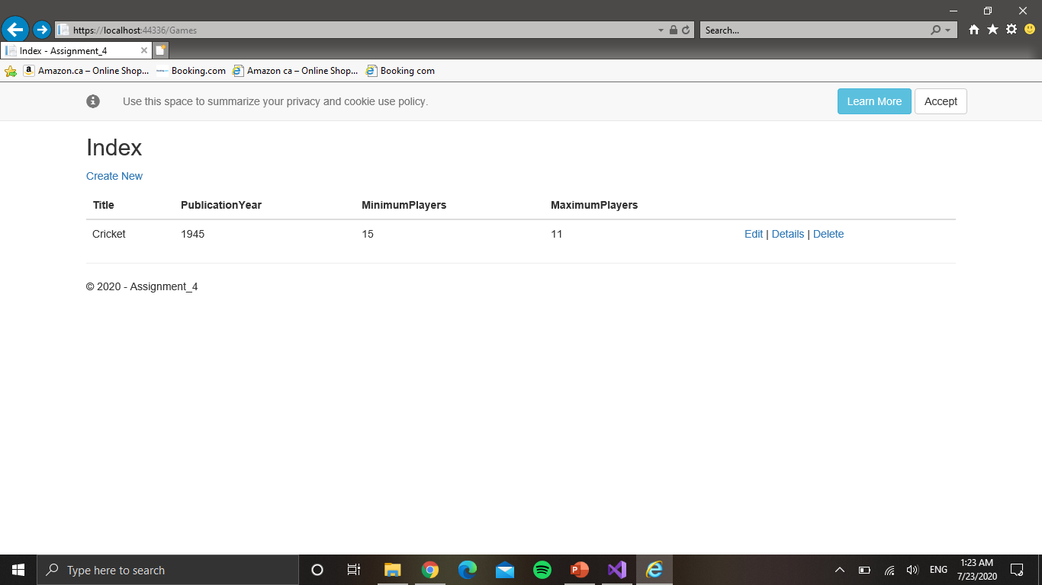
Output

Slide 10
Step 4: Expose a web API from your ASP.NET Core app

Slide 11
Add an API controller
Added API Controller with:
Get
Put
Post
Delete
Adding Swagger

Slide 12
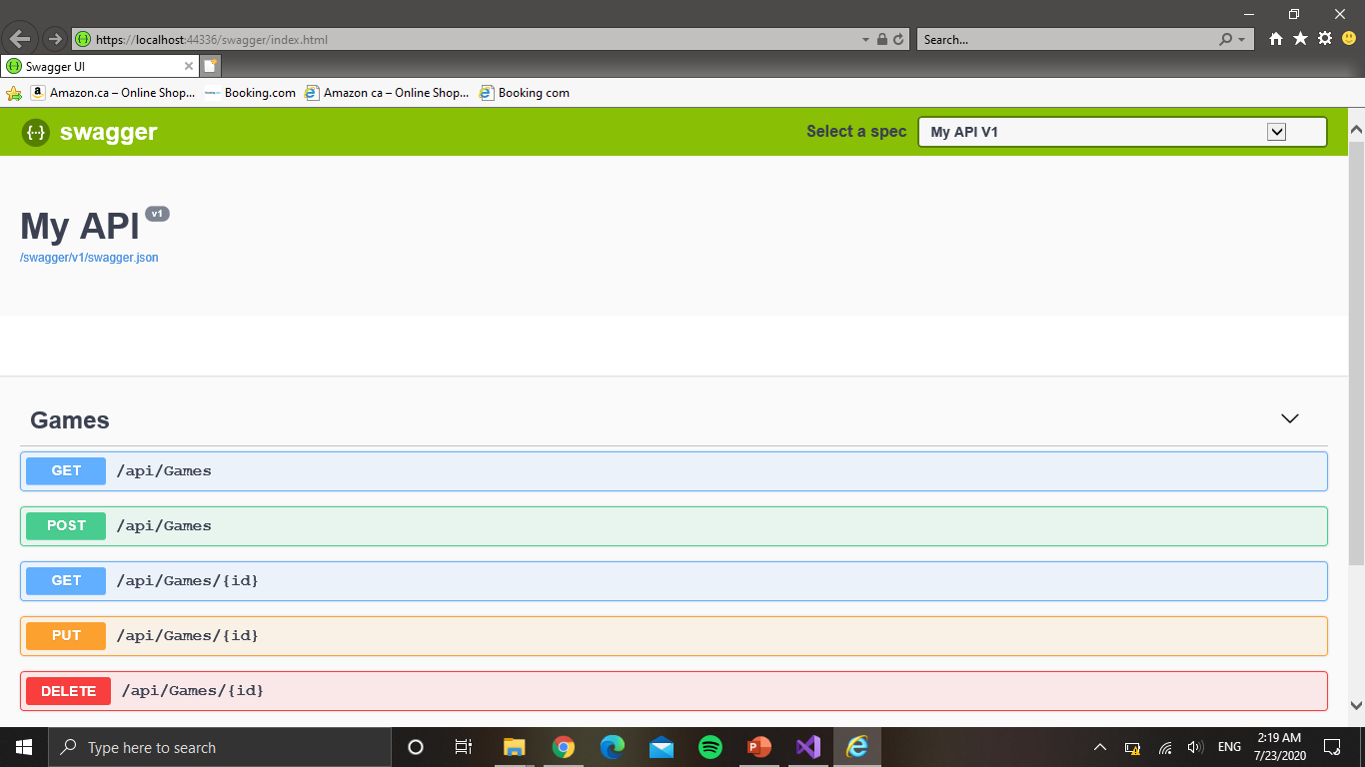
Output:

Slide 13
Step 5: Deploy your ASP.NET Core app to Azure

Slide 14
Add an API controller
Publish to Azure App Service

Slide 15
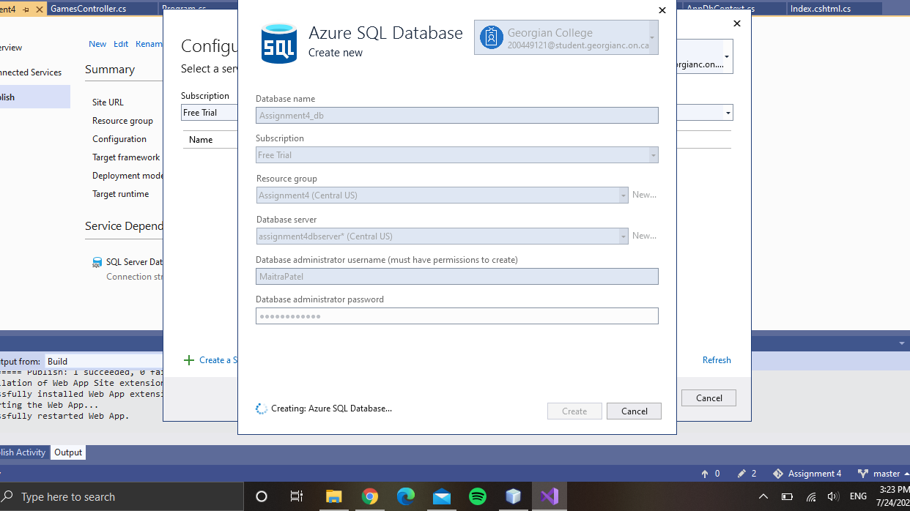
Setting SQL Database

Slide 16
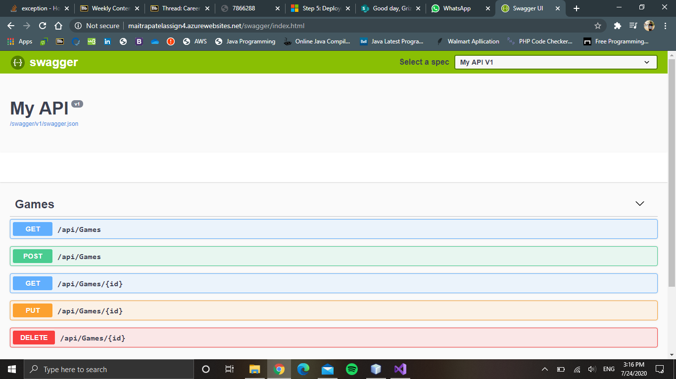
Output of Web Application on Live Link: Swagger Page

Slide 17
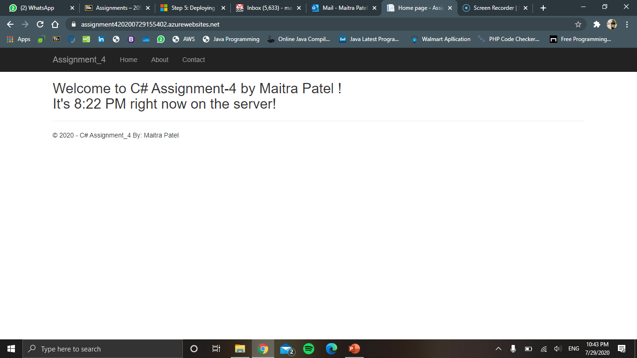
Output of Web Application on Live Link: Home Page

Slide 18
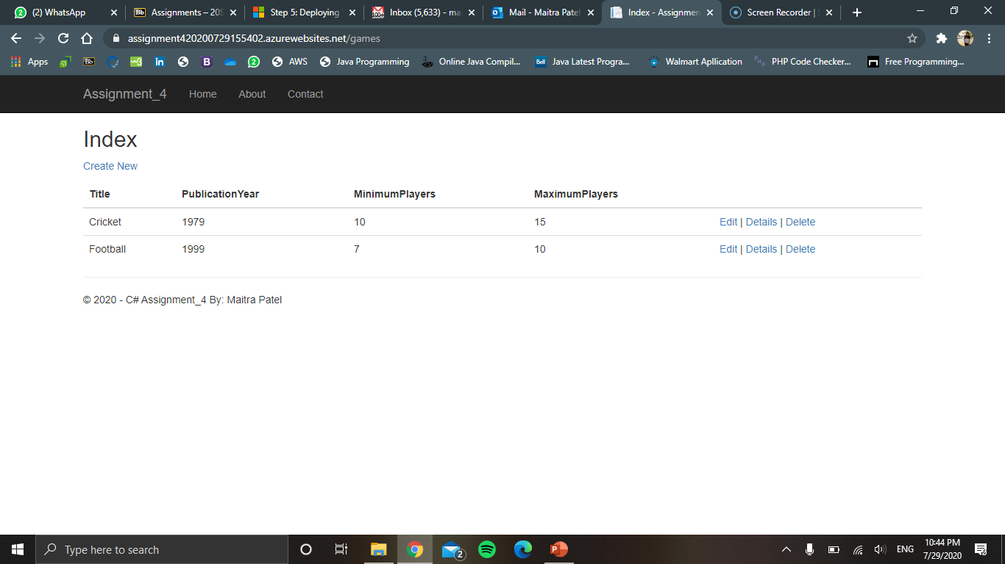
Output of Web Application on Live Link: Games Page

Slide 19

Live Link to my Web Application:
Home Page:
https://assignment420200729155402.azurewebsites.net/
Games Page
https://assignment420200729155402.azurewebsites.net/games
Swagger API:
https://assignment420200729155402.azurewebsites.net/swagger/index.html

Slide 20
GitHub Repository Link
https://github.com/maitravpatel/Assignment4-CSharp

Slide 21
Link to my Presentation Video
https://drive.google.com/drive/folders/1vjSAmYQjzXxP_JO58NW8m3U1zeYBrq-o?usp=sharing

Slide 22

Thank You !

